Slide 1

Launch into Enterprise IT - Reflection
Mark Collins
21/07/2024

Slide 2




Contents
Reflective Models
Course Reflections
Enterprise IT
My Future in Enterprise IT
Notes:
In this presentation, I will provide a brief overview of reflective models, use them to reflect on the course of enterprise IT Management so far, Discuss some reflections on Enterprise IT, and finally look at my role in the future of Enterprise IT.

Slide 3



Introduction & Aims
To critically reflect on the Launching into Enterprise IT Management module.
To answer the statement: “Enterprise IT encapsulates ALL the technology trends that will make the greatest impact on Industry in the next five years”
Consider the future of Enterprise IT and my role within it.
Notes:
There are three main aims to this presentation. The first it to critically reflect on the current module, what my expectations were and how it has improved my knowledge and understanding of the industry.
Second, to provide a response to the statement “Enterprise IT encapsulates ALL the technology trends that will make the greatest impact on Industry in the next five years”.
And finally, provide a reflection on my aspirations and how this course will provide the necessary knowledge and experience to achieve these goals.

Slide 4

Topic One
Reflective Models

Slide 5
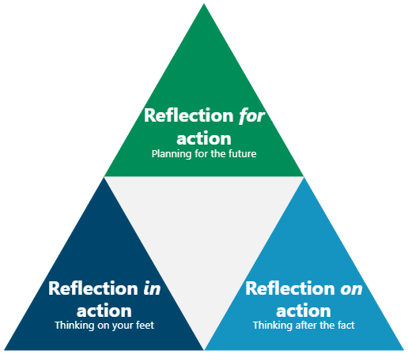
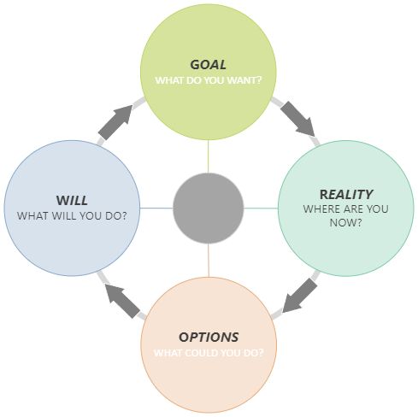
What is reflection?
Notes:
Reflective Practice, particularly in Social Sciences, dates back to the 1983 book by (Schön, 1983). Donald Schön defined “Reflection in action” and “Reflection on action”. Later (Killian & Todnem, 1991) added “Reflection for action”.
While these (and most reflective models) focus on reflecting about a particular event, lets just think about what these mean.
“Reflection on action” is what most people who have encountered reflective practice think of. This is immediately, or soon after, an event or incident. It is a chance to go over either formally or informally about what has just happened, and what can be learnt from it.
“Reflection in action” is essentially thinking on your feet. Imagine yourself in a situation. You are able to draw on previous experience and outcomes and apply to the present. It is what most people do subconsciously every day.
Finally, “Reflection for action” is planning for the future. (Killian & Todnem, 1991) initially intended this as being about to enter a scenario, and reflecting on previous experiences, and going in prepared. However, when I read (Whitmore, 2017) I couldn’t help but feel there was a lot of overlap between coaching and reflective practice. (Whitmore, 2017)’s GROW model is effectively reflective practice for the future – or Reflection for Action.

Slide 6
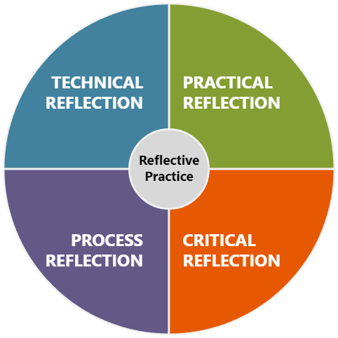
Forms of Reflection
Technical Reflection: What happened? What can be done better?
Practical Reflection: How did it make me feel?
Process Reflection: Who was involved and how did the relationships have an impact?
Critical Reflection: Why did all this happen? Should it? Can influences be changed for the better?
Notes:
(Van Manen, 1977) identified three forms of reflection, which were added to by (Ruch, 2007) to make four forms of Reflection
These can be used individually, or together depending on the scenario and individual.
Technical Reflection: This focuses on the what. “What did I do?” and “What can I do better?”. There is no “Why” or attempt to address the individuals feelings and emotions.
Practical Reflection: This recognises the limits of formal knowledge, and incorporates practice wisdom. The focus is on the self and more open minded than the Technical level.
Process Reflection: This considers relationships and the associated dynamics which influence the situation.
Critical Evaluation: This involves the other three forms, but also challenges the factors influencing a scenario or situation. The other levels consider what is happening, how it can be done better, and how it impacts the individuals involved, but not the why. This form or reflection asks why these factors exist, and should they have the impact they are.

Slide 7
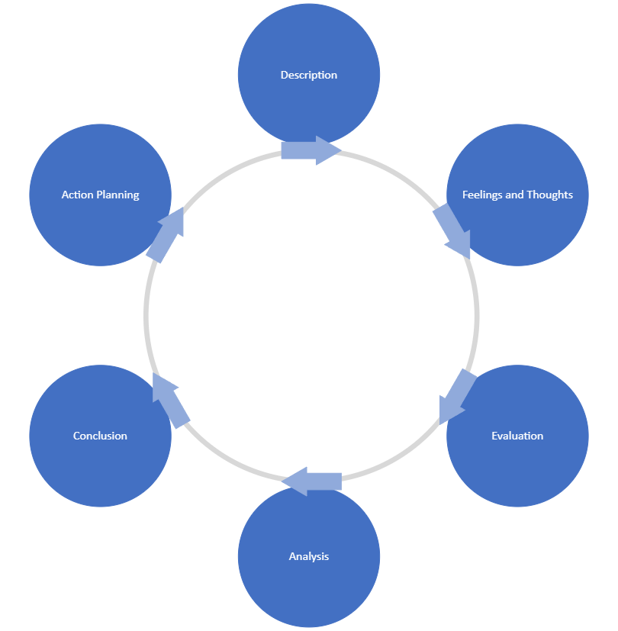
Models of Reflection - Gibbs
Description = Technical & Process
Feelings and Thoughts = Practical Reflection
Evaluation & Analysis = Critical Reflection
Conclusions = Reflection on Action
Action Plan = Reflection for Action
Notes:
There are literally dozens of Reflective models (Maclean, 2016). From my personal experience (Gibbs, 1988) is the model most frequently taught to health and Social Care professionals.
This model incorporates the Forms and Types of Reflection previously mentioned. We start with the Description of what happened (Technical and Process Reflections).
Then we look at thoughts and feelings (Practical Reflection). Next we perform the analysis or Critical Reflection, and draw conclusions (Reflection On Action).
Finally, we make an action plan, or Reflection For Action.

Slide 8
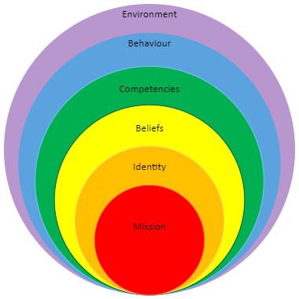
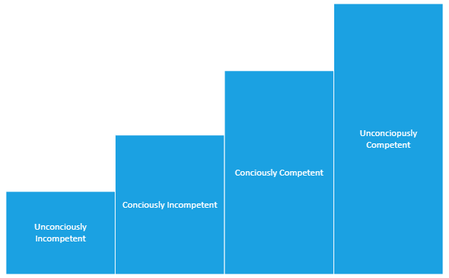
Models of Reflection - Education
Onion Model
Staircase model
Notes:
All the discussion so far has been about reflecting about an event. This is useful for the industry I have previous experience with – Health care, but it needs to be expanded a bit for educational settings.
The “event” in this scenario, is the 12 week module and the reflection is on the content, and what conclusions I can draw for the future of Enterprise IT.
For this, we will look at two models used in Education settings. The first one, that I have used previously when teaching new staff members it what I like to call the “Competency Staircase”. This is actually the Four stages of competence, or the Competency Hierarchy (Keeley, 2021). I like referring to it as a staircase as it implies a journey of progression.
The other model used in education is The Onion model (Korthagen & Vasalos, 2005). This focusses on the drivers and motivators of an individual. The “why” a person undertakes training or learning. This can be used to reflect on if the individual gained what they intended.
Working from the outside-in, we can see the environment affects our behaviour, which impacts on competencies, etc. But it also works from inside out, where our “Core” personality, our “Mission” or Motivation, affects our Identity and beliefs etc.

Slide 9

Topic Two
Reflections on the Course

Slide 10
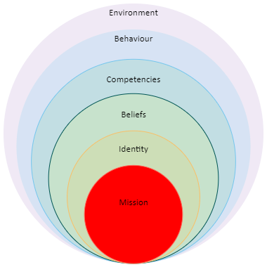
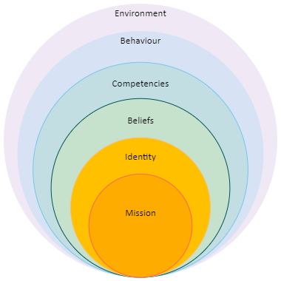
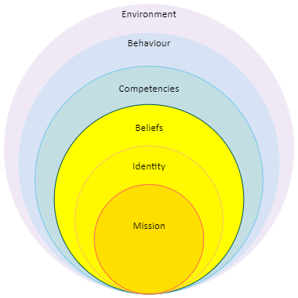
Core Reflection
Mission
Identity
Beliefs
Formalise on-the-job learning
Career aspirations – strategic leadership role
Professional
Knowledgeable
Student
Capable
“I can do this”
Intelligent
“I know more than I thought”
Notes:
Starting from the centre of the Onion, my “Mission” or Motivation for starting this Course was to formalise what I have learnt on the job over the last decade or so. This has certainly been the case – a number of topics have been discussed where I had the knowledge and experience but didn’t know it, for example it turns out I have been using BPMN/UML for years without knowing that’s what it was.
I also have career aspirations to progress to a strategic leadership role. One module in, and it feels like this might be a reality. Discussing the history of Enterprise IT and decisions made, both good and bad has provided the opportunity to learn from others experience in this area. Also, the EITBOK (IEEE - Computer Society, 2017) gives that “higher-level”, strategic overview of an Enterprise Architecture.
In terms of Identity, it has been interesting being a student again. Despite being a professional, who it turns out is already knowledgeable through experience, I am still learning a lot from this course. The power dynamic is different from formal study in the past though. The course tutors have treated myself and my course mates as professionals. There is still a teacher – student dynamic, but it is more a sharing knowledge through conversation, and not a one-way lecture style interaction.
This has ultimately lead me to believe in myself, that I am capable of completing the course. Prior to the course starting I had some self-doubt in my ability to progress my career. When I graduated from my first degree, I had a career mapped out. Unfortunately, that was 15 years ago, and my job in defence research was withdrawn due to recession and government spending cuts. Since then my focus has been on job security, rather than career progression. I had started to think that without further qualifications, I would be stuck in my current role, but I now believe that this course will give me the skills necessary to advance within the industry of Enterprise IT.

Slide 11
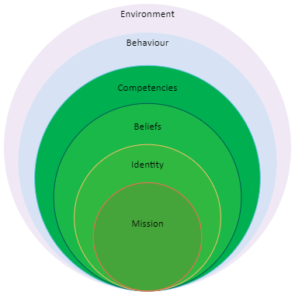
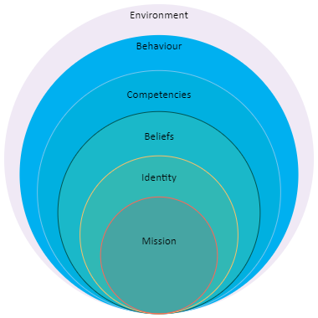
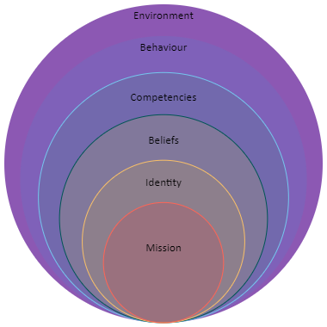
Reflection – Outer layer
Competencies
Behaviour
Environment
Referencing
Programming – Python
Research Skills
UML/BPMN
Group work
Managing time effectively
Confidence
Course vs Work vs Family time
Course impact on work
Enterprise IT as an Industry
Notes:
Moving out to the Competency layer, I have learnt a number of new skills in this module. I have refreshed my competencies with regards to Referencing and research, and proven that I can take the programming skills I have obtained elsewhere and apply them to Python. Finally, I have been using BPMN/UML for a number of years, without knowing it. Covering it in the unit in this module has provided extra competence and confidence in using it correctly.
The Confidence the inner layers of the Onion have given me, has impacted my behaviour. I am managing time effectively, I am working collaboratively with my peers, and this has filtered over into my professional and personal life. I have better focus on my work tasks, and am able to balance my commitments effectively.
Finally, last but not least, the Environment. It has been a challenge to juggle the Course, Work, Family and down time. My wider environment impacts my learning in both positive and less-positive ways. Finding time is difficult, but maintaining downtime allows for clearer thought. Walking dogs etc. means I can clear my thoughts and work-out how to phrase a paragraph, or link ideas from multiple sources together, or just allow ideas to sink in.
The reverse is also true. The Course has had a positive impact on the way I see things at work. Through better use of UML for mapping patient flows in the Hospital I work in or being able to think about the IT infrastructure in a different way when contributing to my departments strategy.

Slide 12

Topic Three
Enterprise IT

Slide 13
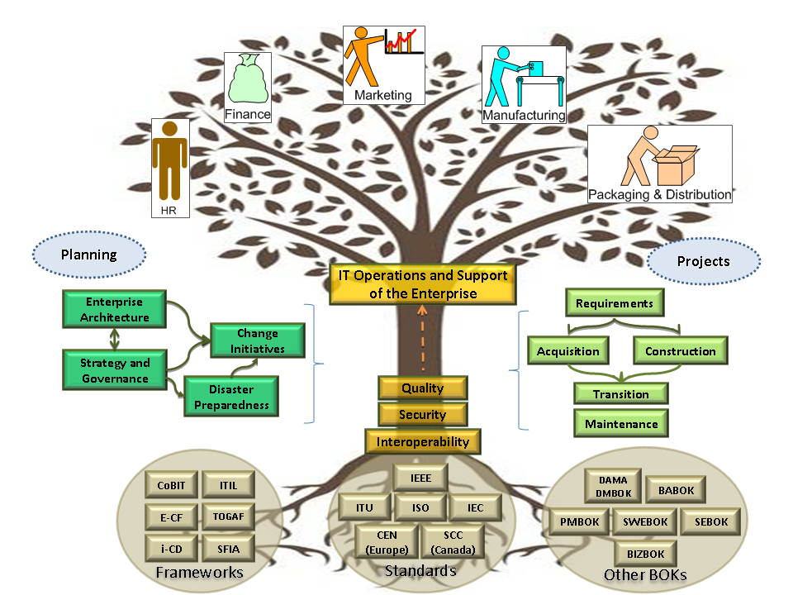
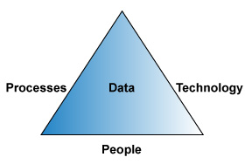
Environment - Enterprise IT
Notes:
When using the Onion reflective model, the environment that is important is that of Enterprise IT. Enterprise IT management involves supporting a business or organisation with their business needs for automation and information technology, planning and managing changes to technology and on-going support for the technology (IEEE - Computer Society, 2017).
This involves understanding and managing the Processes, Technology, People, and the Data of the organisation.

Slide 14
Trends in EIT
Big Data and Predictive Analytics
Social Platforms
Cyber Security and Data Privacy
Better protect:
Enterprise technology assets
Customer information
Employee information
EIT’s services from operational disruption
EIT’s community and work against terrorism and external attack
Figuring out how to comply with gov. and industry regulations
Cloud Services and SOA
Mobility for the Enterprise’s workforce and customers
Architectural Changes
Notes:
The EITBOK (IEEE - Computer Society, 2017) identifies the following trends in EIT:
Big data and predictive analytics
Social platforms, and
Cyber Security and Data Privacy
Of the fist two, Security and Privacy will play a significant role. The aim of Security and Privacy is to better protect the organisations Assets and Information, and guard against operational disruption, be that technical or malicious. Also it requires figuring out how to comply with government and industry standards on data privacy.
The EITBOK also breaks down Security and Privacy further, looking at:
Cloud services and Service Oriented Architecture
Mobility for the Enterprises workforce and customers, and
Architectural changes.

Slide 15
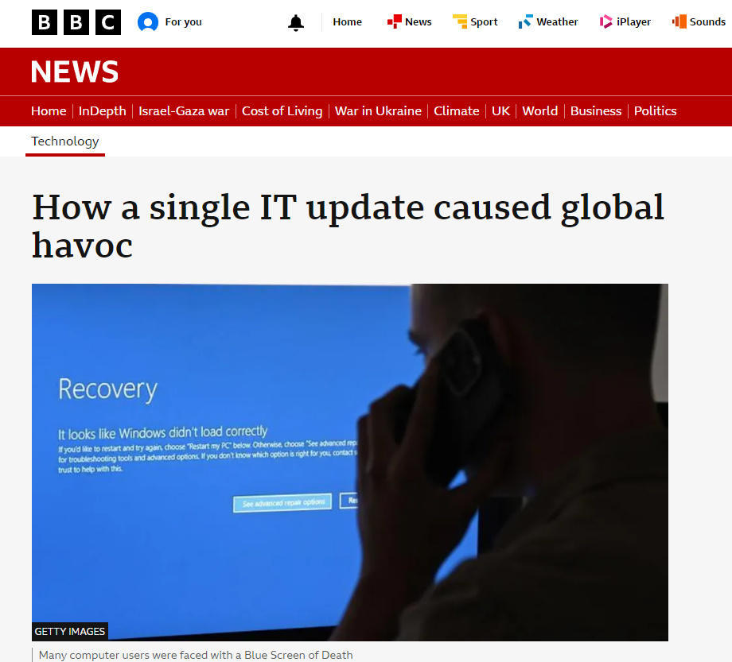
Question?
Enterprise IT encapsulates ALL the technology trends that will make the greatest impact on Industry in the next five years
Notes:
So this is the point I implement Reflection In Action, and make some last minute changes to this presentation.
I was planning on choosing Cloud Services and a technology to focus on, and start singing its praises, but on the 19th July, a third party security update to Microsoft cloud services, caused global outages across every sector (Kleinman, 2024). The fall-out is not yet clear, but conservative estimates place the financial impact in the Billions of dollars.
So, yes. Enterprise IT and management has a huge impact on all industries, and the trends identified in the EITBOK cover those with some of the biggest impact.

Slide 16

Cloud Services – the new outsourcing
SaaS
PaaS
FaaS
Notes:
So, let’s have a reflection on cloud services.
In my opinion, cloud hosted solutions will bring about the same level of impact on industry as a whole as the outsourcing boom in the 90’s and early 2000’s (Booth, 2017).
Following COVID, we saw many industries moving to working remotely. This required rapid digitisation of industries that had not fully digitised, and expansion of those that were well on their way.
The only practical way this was possible was through the utilisation of cloud-based services. Individual organisations do not have the infrastructure on-premises to accommodate the rapid uptake. Be that through physical equipment (servers etc.), power requirements for additional IT hardware, or staff to manage and maintain.
Using cloud based services, organisations were able to quickly adopt remote digital working, and take advantage of economies of scale.

Slide 17
Cloud Services
Pros
cons
Remote/hybrid working
Rapid expansion
Economy of scale
Reduced on-prem. support
Loss of data control
Increased attack surface
Less control over upgrade and change management
Single Point of Failure
Notes:
Of course, as with anything, Cloud Services are a double edges blade. While it has its advantages of allowing staff to work remotely, allows the easy and rapid expansion based on business needs, and allows organisations to take advantage of economies of scale, buy effectively pooling resources, there are considerable downsides.
The initial concerns are over the security of the data held in cloud services. The data is no longer physically held within the control of the data owner, meaning there must be an element of trust between the organisation and the cloud provider.
By allowing employees to access this data from anywhere, on potentially any device, an organisation leaves themselves open to a greater attack surface from malicious intent. More uncontrolled devices connecting, leads to more sources of security breaches.
My greatest concern over cloud-based services, is one that came to fruition this weekend. There is very little control by the end user over software and platform upgrades. Combined with concerns raised by the CTO of 37signals (McManus, 2024) that by relying on cloud services, there are only three main contenders, meaning if one goes down, that’s a third of the internet out.
By the looks of things, that is what happened this weekend (Kleinman, 2024). Cloud Strike pushed out an update to their end-point protection to Microsoft cloud products, and caused every service that relies on this to be out of action and cause global chaos.
Enterprise IT Management should provide the framework to prevent this kind of issue, by having robust change management measures in place – phase G and H of TOGAF (Desfray & Raymond, 2014).
Of course there are times when you can have robust User Acceptance, and issues still slip through. For example, only last month, I implemented new SQL reports provided by a statutory body. I tested them in our UAT environment and all worked, however my UAT database is much smaller than my production, and a script that concatenates a number of serial numbers was defined as an integer, however the production database had too many entries, and the memory allocation for Integer was insufficient, and it needed to be changed to BigNumber.

Slide 18

My future in Enterprise IT
Strategic leadership
Robust Change Management
Best Practices
Notes:
This leads us on to how I see my role in Enterprise IT going forward.
I see myself taking a strategic leadership role within either my current, or similar organisation. Using Enterprise IT models such as TOGAF (Desfray & Raymond, 2014), putting measures in place that allows the use of cloud based services, taking advantage of all the pro’s, such as expansion and ease of access to data by those who need it, but also protecting the organisation from security breaches and total system failure by implementing robust change management and following security best practices.

Slide 19


References
Booth, T. (2017) Here, there and everywhere. Available from: https://www.economist.com/special-report/2013-01-19 [Accessed 20th July 2024]
Desfray, P., & Raymond, G. (2014) Modeling Enterprise Architecture with TOGAF. London: Elsevier.
Gibbs, G. (1988) Learning by Doing: A Guide to Teaching and Learning Methods. Oxford: Further Education Unit Oxford Polytechnic.
IEEE - Computer Society (2017) EITBOK - Enterprise IT. Available from: http://eitbokwiki.org/Main_Page [Accessed 20th July 2024]
Keeley, C. (2021) Conscious competence model and medicine. Foot & Ankle Surgery: Techniques, Reports & Cases, 1(3): 100053. DOI: https://doi.org/10.1016/j.fastrc.2021.100053
Killian, J., & Todnem, G. (1991) Reflective judgment concepts of justification and their relationship to age and education. Journal of Applied Developmental Psychology, 2(2): 89–116.
Kleinman, Z. (2024) How a single IT update caused global havoc. Available from: https://www.bbc.co.uk/news/articles/cpwdyxx0v64o [Accessed 20th July 2024]

Slide 20
References
Korthagen, F., & Vasalos, A. (2005) Levels in reflection: Core reflection as a means to enhance professional growth. Teachers and Teaching: Theory and Practice, 11(1): 47–71. DOI: https://doi.org/10.1080/1354060042000337093
Maclean, S. (2016) Reflective Practice Cards. Litchfield: Kirwin Maclean Associates.
McManus, S. (2024). Are rainy days ahead for cloud computing? Available from: https://www.bbc.co.uk/news/articles/cd114lllyp6o [Accessed 20th July 2024]
Ruch, G. (2007) Reflective Practice in Contemorary Child-care Social Work: the role of containment. British Journal of Social Work, 37: 659–680.
Schön, D. (1983) The Reflective Practitioner: How Professionals think in action. London: Temple Smith.
Van Manen, M. (1977) Linking ways of knowing with ways of being practical. Curriculum Inquiry, 6: 204–228.
Whitmore, J. (2017) Coaching for Performance (5th ed.). London: Nicholas Brealey Publishing.

Slide 21
Thank You
Mark Collins
Mark.Collins@porthosp.nhs.uk

